Slide 1





Smart Click
Multi-Location Wireless Light Switch

Slide 2
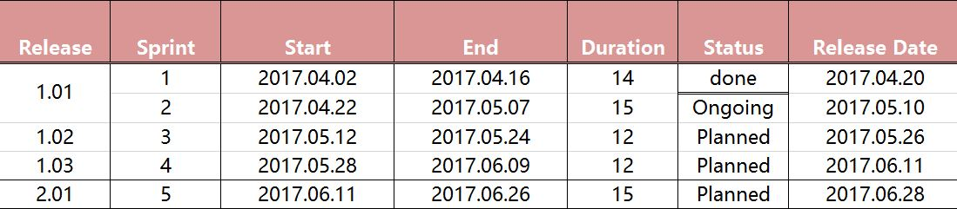
Release Plan

Slide 3
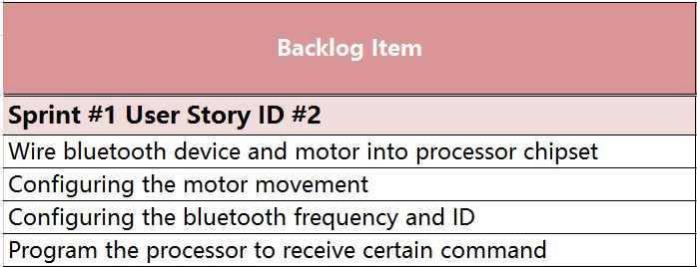
Sprint 1 Backlog
As an User I want swipe the control button on my application

Slide 4
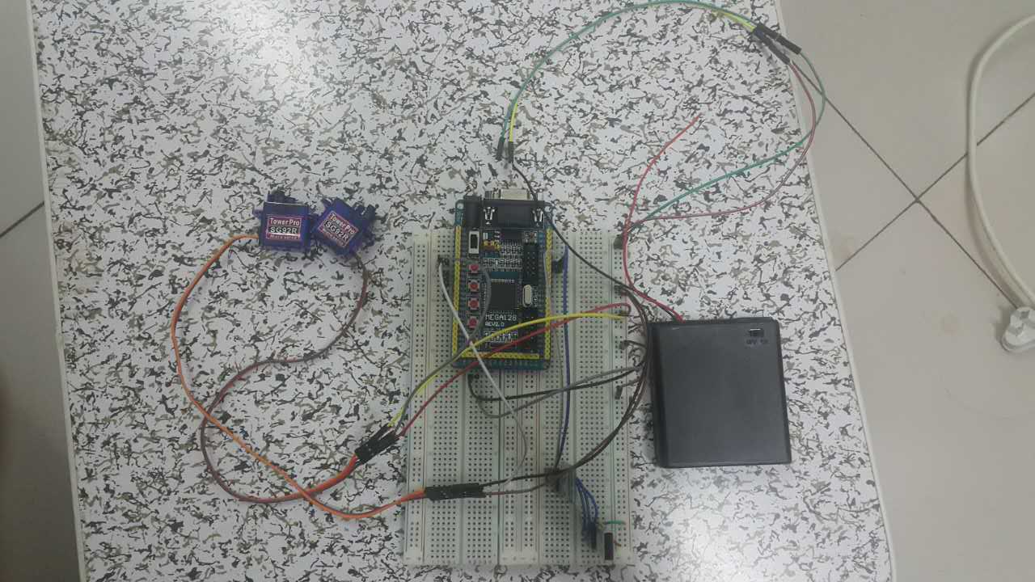
Wire bluetooth device and motor into processor chipset
Atmega 128
Main processer

Slide 5
Configuring the motor movement
Servo Motor

Slide 6
Configuring the bluetooth frequency and ID
Bluetooth Chipset

Slide 7
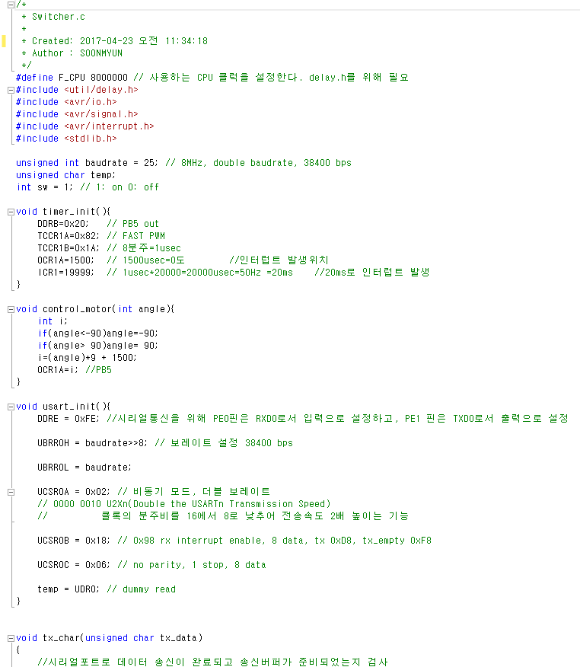
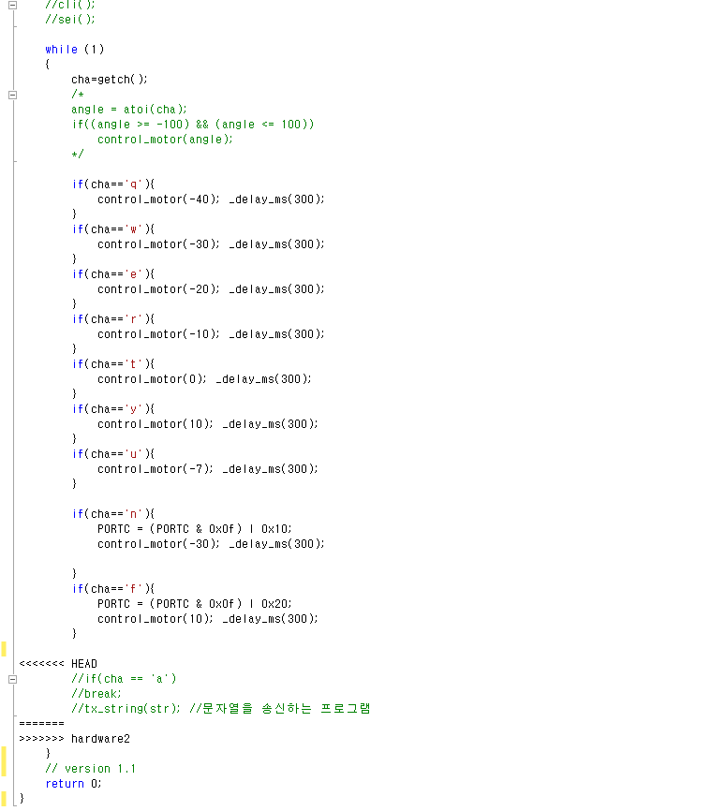
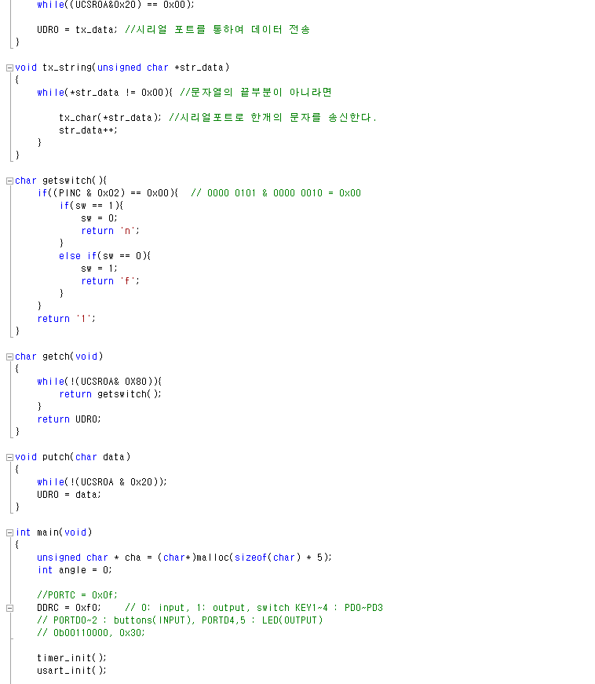
Program the processor to receive certain command
Notes:
Version Management :
When independent development management not overlap each other.
Change Management :
Tracking the changing requirements Management

Slide 8
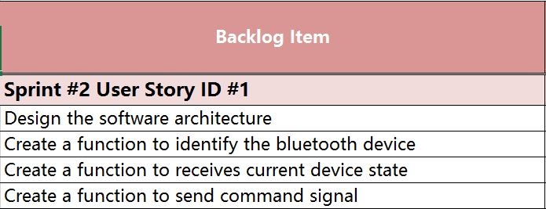
Sprint 2 Backlog
As an User I want my application to control the light switch

Slide 9
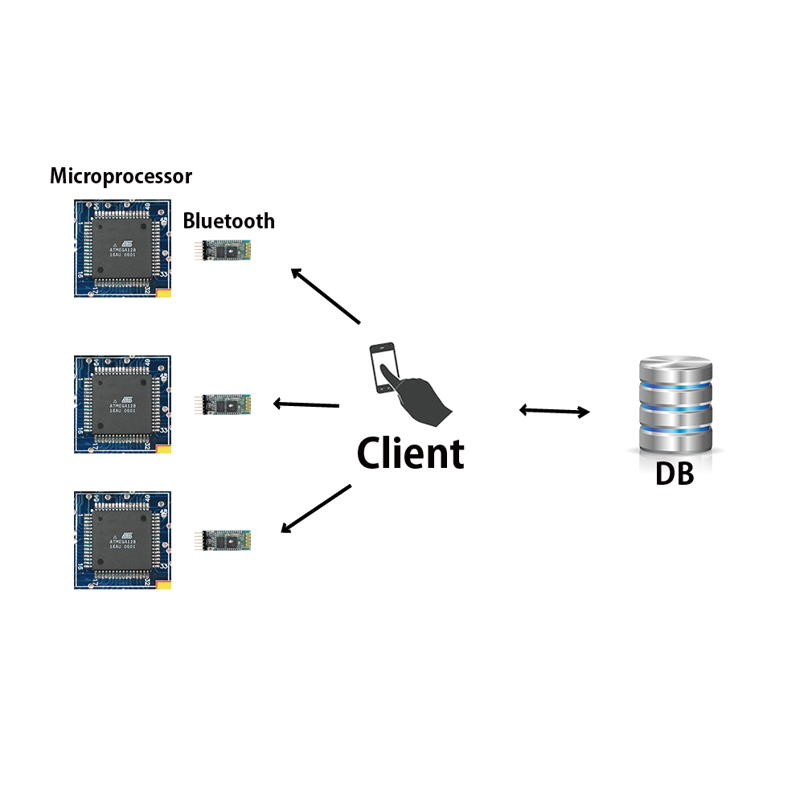
Configuration Architecture
Notes:
This is configuration architecture.

Slide 10
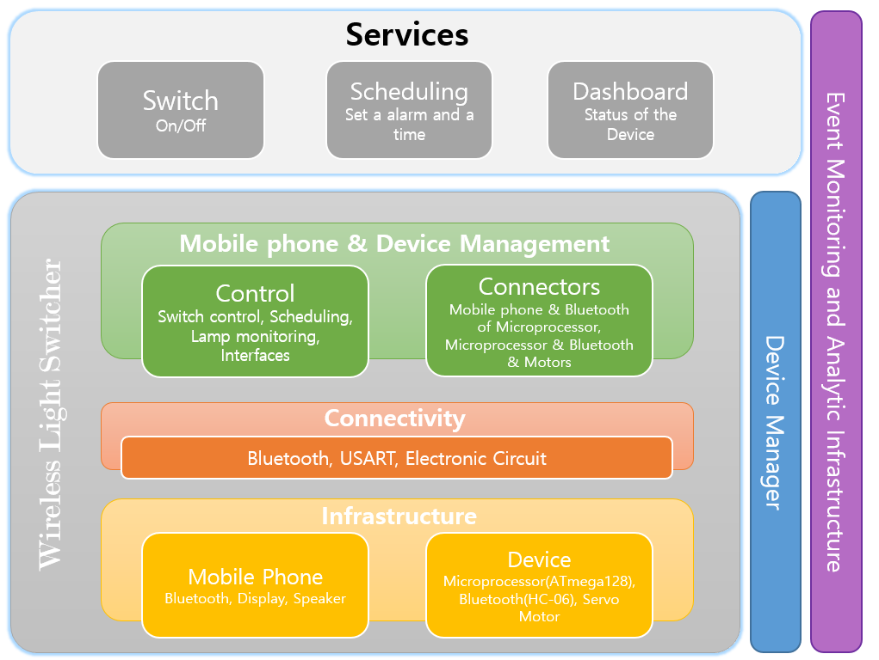
Conceptual Architecture

Slide 11
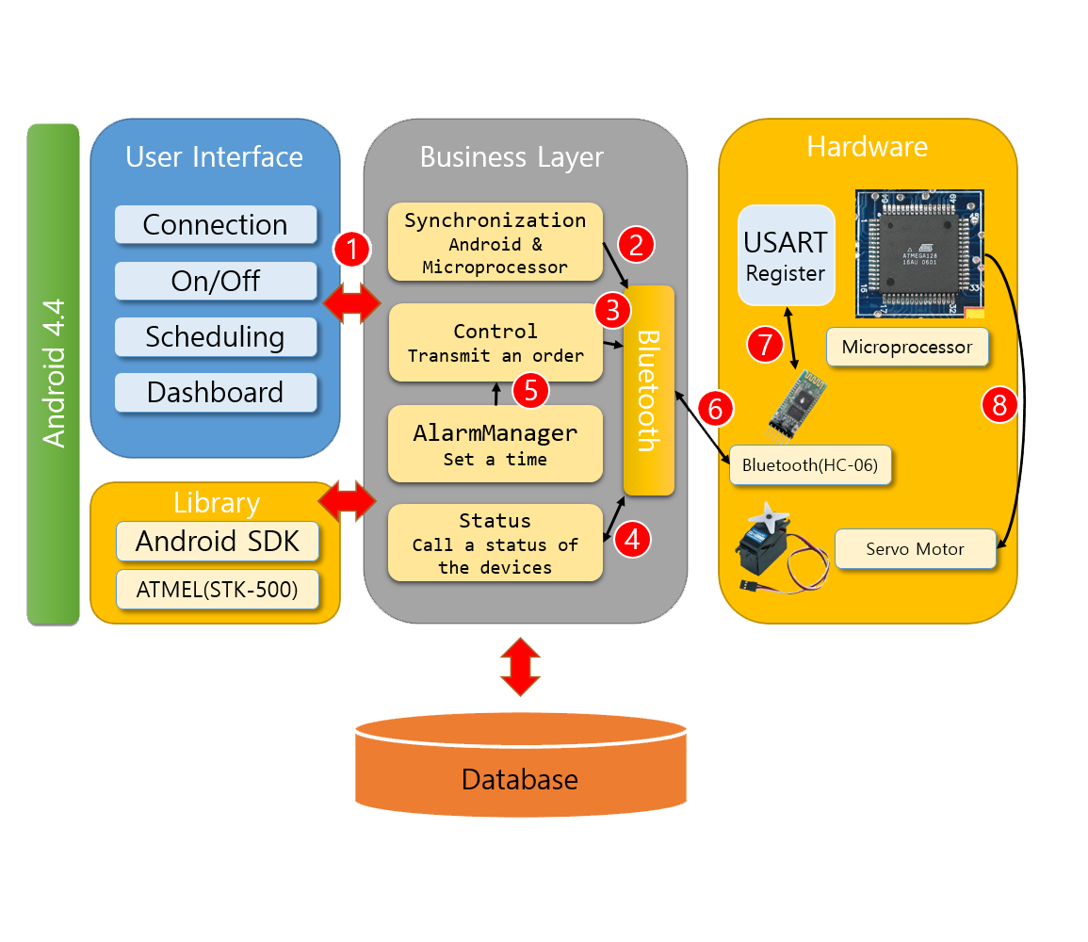
Logical Architecture

Slide 12
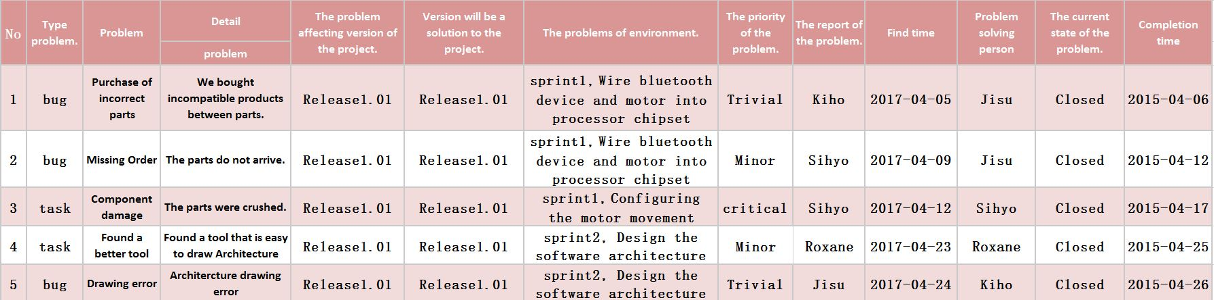
Defects Management

Slide 13


